Slide 1
Event Storming
or How I learned to stop worrying and love requirement meetings

Slide 2
Goal
To give an introduction into Domain Driven Design Strategic Patterns using an interactive Event Storming exercise

Slide 3
What is Domain Driven Design?
DDD is “primarily about modeling a Ubiquitous Language in an explicitly Bounded Context”
(From Domain Driven Design Distilled, Vernon 2016)
Strategic Patterns focus on the big picture
Tactical Patterns focus on the code
Notes:
DDD

Slide 4

Car Simulator
We will be designing a driving game that will work with VR devices.
Players will be able to drive, design, buy and sell new and used cars, and interact with other players

Slide 5
The First MMF
Provide a realistic driving experience in ideal weather conditions
Driving will result in normal wear and tear on the vehicle
A standard set of cars can be bought and sold in the market place with limited customizations
Used cars can be sold to other players at the seller’s price

Slide 6
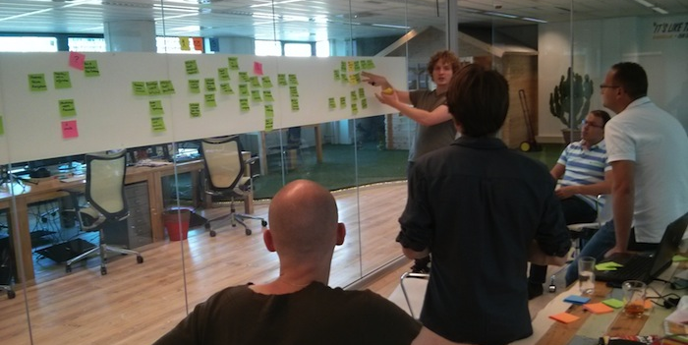
What is event storming?
Notes:
Modeling exercise designed to bring the development team and outside domain experts together
Focuses on process discovery over entities
Goal is to produce a rough domain model to be used in development

Slide 7
Roles
Developers: Members of the team developing the system
Domain Experts: Members of the team with expert knowledge in all or part of a given domain
I will serve as facilitator and Product Owner for this exercise

Slide 8

Domain Events
An important event in the context of the Domain
Internal and external processes will then consume these events

Slide 9

Step #1: Identifying the Domain Events
For review, Domain Events are an important event within a bounded context
Place Domain Events in chronological order on a sticky note
Events that happen concurrently are placed within the same vertical plane
Processes that are kicked off by Events are written on Lilac colored sticky notes
Notes:
20 minutes for this exercise
Start by placing three domain events onto the paper
Domain Events need to be a past tense verb
Processes are kicked off onto a Lilac colored note

Slide 10

Step #2: Identifying the Cause
Identify the Command that caused each Domain Event
Write the Command on a sticky note
Place directly to the left of the Domain Event
Specific Roles are written on a bright yellow sticky in the lower left corner of the command
Processes that are kicked off by Commands are written on Lilac colored sticky notes
Notes:
15 minutes
If specific role write on a small yellow sticky
Processes that are kicked off will be placed on a lilac sticky note

Slide 11

Step #3: Who did it?
Identify the associated Entity (Aggregate) to each Command/Event pair
Place it on a sticky behind the pair
Note common Entities without rearranging them
Notes:
15 minutes

Slide 12
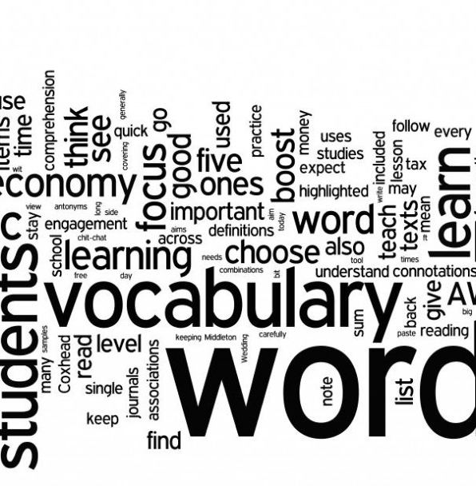
A Shared Language
Words may have different meanings depending on perspective
Ubiquitous Language is a shared language within the Bounded Context agreed to by the team

Slide 13
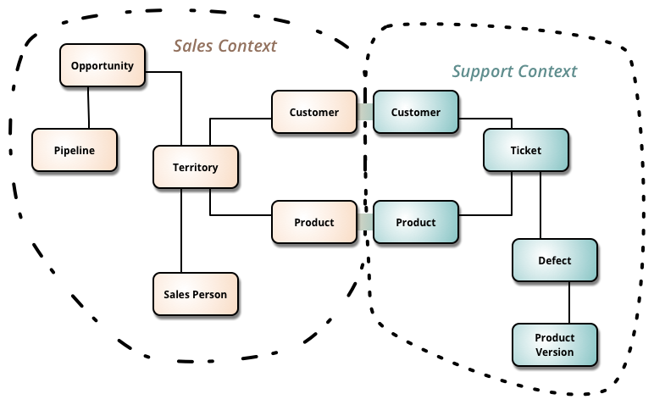
Language in a Context
A bounded context is a linguistic boundary around Ubiquitous Language
Like concepts go together while foreign concepts are outside
Notes:
Each of the lines drawn in step 4 constitute a bounded context

Slide 14
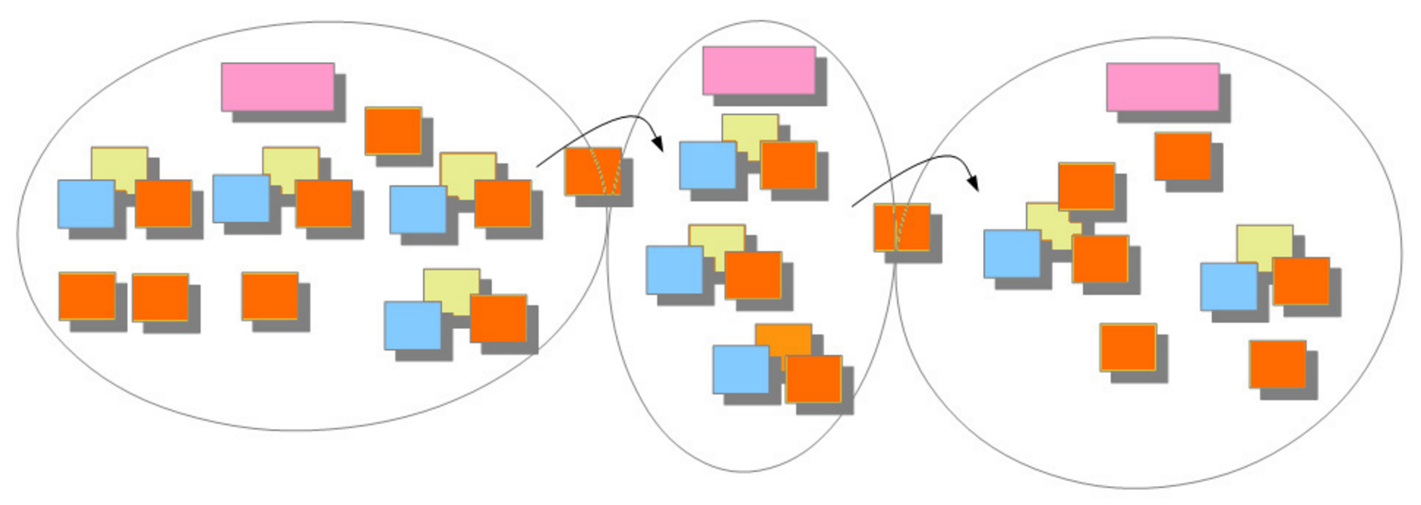
Step #4: The Dividing Line
Look for divisions in the model to identify Bounded Contexts
Draw solid lines for Bounded Contexts and dashed Lines for subdomains
Use Pink Sticky Notes to name the Bounded Contexts
Draw arrows to show the flow of information across Contexts
Notes:
I will do

Slide 15

Step #5: What do we see?
Identify any Views and put them within each Bounded Context
Role specific Views have a bright yellow sticky with the Role
If necessary, draw a quick mock up of the View
Notes:
I will do
Talk about division being on small changes in definition

Slide 16
Event Storming Review
Event Storming is a Process Oriented modeling exercise used to fast track development
Involves Domain Experts and Developers
Can be used for individual systems (like this example) or big picture discussions

Slide 17

Focusing on the Core
Focus on developing the driving portion first, which is the Core Domain
Supporting Subdomains and Generic Domains should be off the shelf or have less time spent

Slide 18
Further Resources
Presentation out on Github: https://github.com/rattrapdev-public/public-files
Email: mateo6379@gmail.com
Twitter: @rattrap79

